Slide 1
Mutual Exclusion
To guarantee consistency among distributed processes that are accessing shared memory, it is necessary to provide mutual exclusion when accessing a critical section.
Assume n processes.
Mutual exclusion algorithm
1. Centralized Algorithm
2. Distributed Algorithm
3. Token Ring Algorithm

Slide 2
A Centralized Algorithm for Mutual Exclusion
Assume a coordinator has been elected.
A process sends a message to the coordinator requesting permission to enter a critical section. If no other process is in the critical section, permission is granted.
If another process then asks permission to enter the same critical region, the coordinator does not reply (Or, it sends “permission denied”) and queues the request.
When a process exits the critical section, it sends a message to the coordinator.
The coordinator takes first entry off the queue and sends that process a message granting permission to enter the critical section.

Slide 3
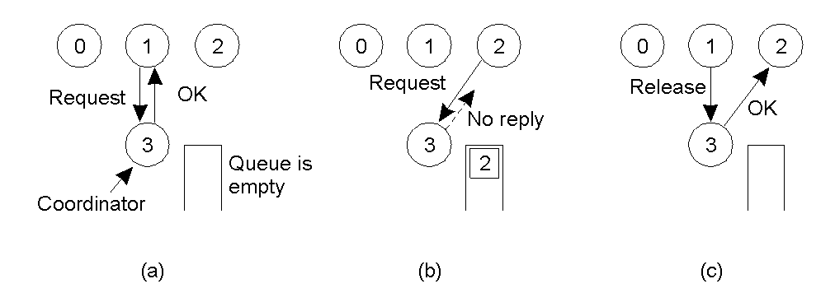
A Centralized Algorithm for Mutual Exclusion

Slide 4
A Distributed Algorithm for Mutual Exclusion
Ricart and Agrawala algorithm (1981) assumes there is a mechanism for “totally ordering of all events” in the system (e.g. Lamport’s algorithm) and a reliable message system.
A process wanting to enter critical sections (cs) sends a message with (cs name, process id, current time) to all processes (including itself).
When a process receives a cs request from another process, it reacts based on its current state with respect to the cs requested. There are three possible cases:

Slide 5
A Distributed Algorithm for Mutual Exclusion (cont.)
If the receiver is not in the cs and it does not want to enter the cs, it sends an OK message to the sender.
If the receiver is in the cs, it does not reply and queues the request.
If the receiver wants to enter the cs but has not yet, it compares the timestamp of the incoming message with the timestamp of its message sent to everyone. {The lowest timestamp wins.}
If the incoming timestamp is lower, the receiver sends an OK message to the sender.
If its own timestamp is lower, the receiver queues the request and sends nothing.

Slide 6
A Distributed Algorithm for Mutual Exclusion (cont.)
After a process sends out a request to enter a cs, it waits for an OK from all the other processes. When all are received, it enters the cs.
Upon exiting cs, it sends OK messages to all processes on its queue for that cs and deletes them from the queue.

Slide 7
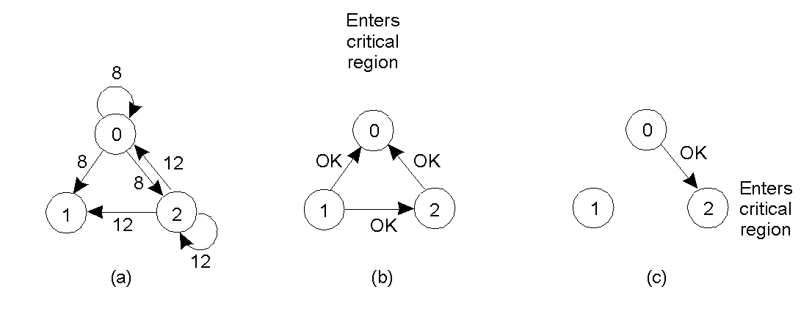
A Distributed Algorithm for Mutual Exclusion
Two processes want to enter the same critical region at the same moment
Process 0 has the lowest timestamp, so it wins
When process 0 is done, it sends an OK also, so 2 can now enter the critical region

Slide 8
A Distributed Algorithm for Mutual Exclusion
Process 0 sends everyone a request with timestamp 8, while at the same time, process 2 sends everyone a request with timestamp 12. Process 1 is not interested in entering the critical region, so it sends OK to both senders.
Process 0 and 2 both see the conflict and compare timestamps.
Process 2 sees that it has lost, so it grants permission to 0 by sending OK.
Process 0 now queues the request from 2 for later processing and enters the critical region.
When process 0 finishes, it removes the request from 2 its queue and sends an OK message to process 2, allowing to enter into critical region

Slide 9
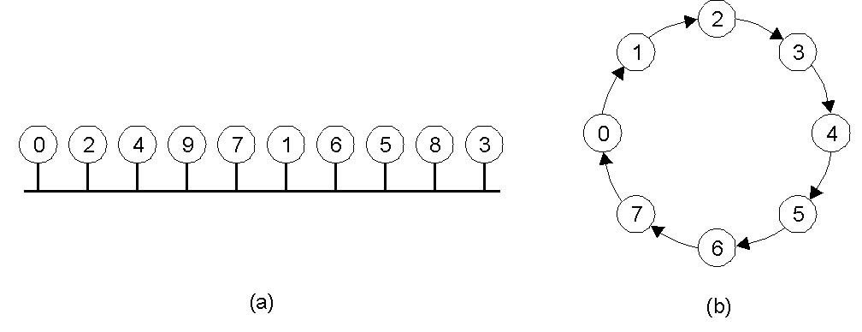
A Token Ring Algorithm
An unordered group of processes on a network.
A logical ring constructed in software.
Process must have token to enter.
If don’t want to enter, pass token along.
If host down, recover ring. If token lost, regenerate token.

Slide 10
Mutual Exclusion Algorithm Comparison
Algorithm | Messages per entry/exit | Delay before entry (in message times) | Problems
Centralized | 3 (a request, a grant, a release) | 2 | Coordinator crash
Distributed | 2 ( n – 1 ) (n – 1) request message (n –1 ) grant message | 2 ( n – 1 ) | Process crash
Token ring | 1 to ∞ (Token may sometime circulate for hours without anyone being interested in it) | 0 to n – 1 (Time 0 : token just arrive) (Time n – 1 : token just departed) | Lost token, process crash
Centralized is the most efficient.
Token ring efficient when many want to use critical region.

